Slide 1
KPI analysis and recommendations
Pallavi Mohapatra
Student Id: 20184267

Slide 2
Introduction
FoodCorp is a retail chain operating in three regions across four stores.
Need to identify store to focus on marketing spend.
Selection of a set of KPIs for subsequent comparison.
Comparative analysis across all stores using relevant metrics using SQL and Tableau.
Developing a strategy to pick store for marketing investment.

Slide 3
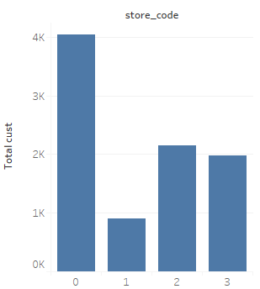
Store Size
Store size is defined as the number of customers who have visited the store over the whole time period.
Distinct customer base size for stores.

Slide 4
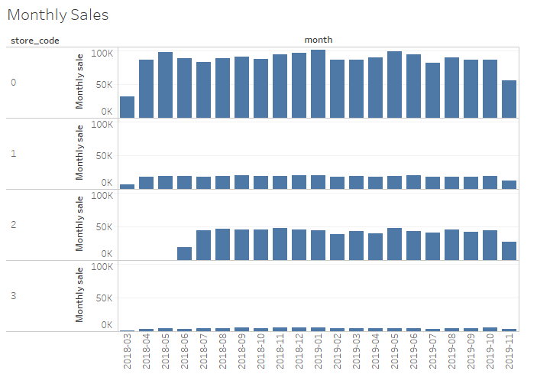
Monthly Sales
Financial performance metric to measure growth across the time period.

Slide 5
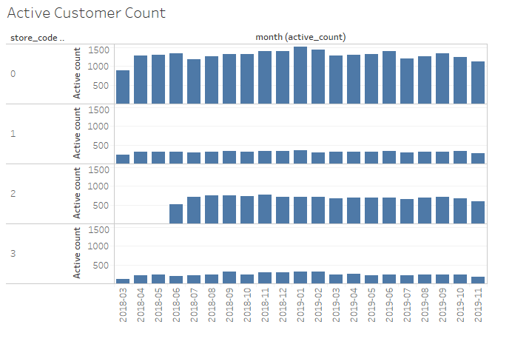
Active Customer Count
Customer metric to measure growth and engagement.

Slide 6
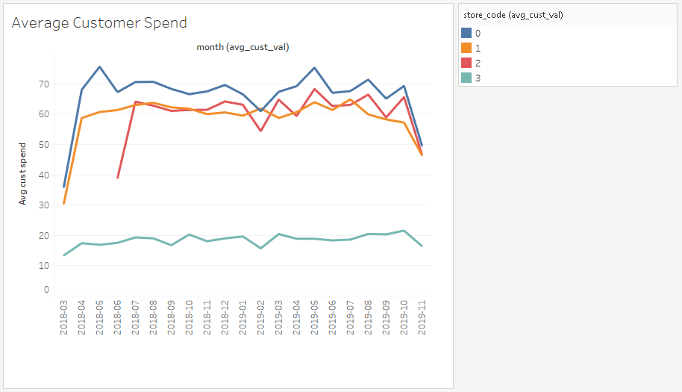
Average Customer Spend
Metric to measure average revenue from each customer.

Slide 7
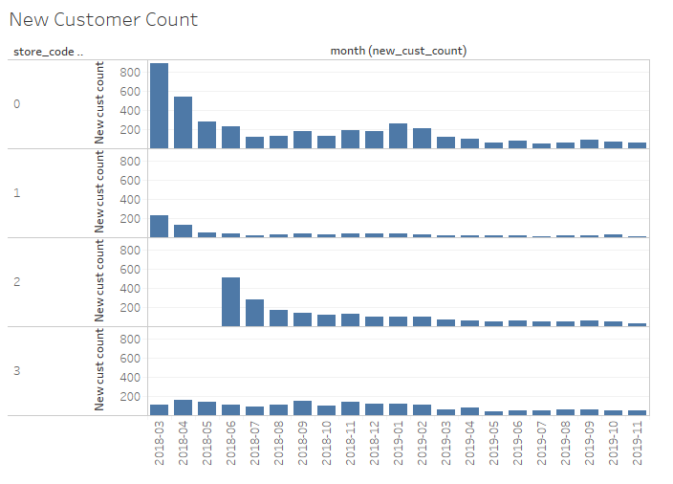
New customers count
Customer metric to measure new customer acquisition rate.
Indicator of growth.

Slide 8
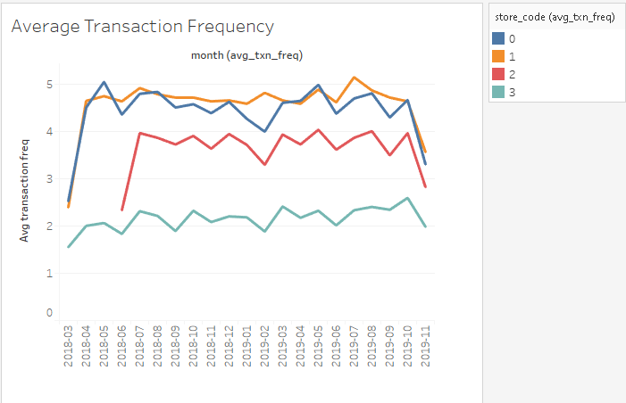
Average Transaction Frequency (Repeat Rate)
Stands for repeat rate.
Indicator of engagement.

Slide 9
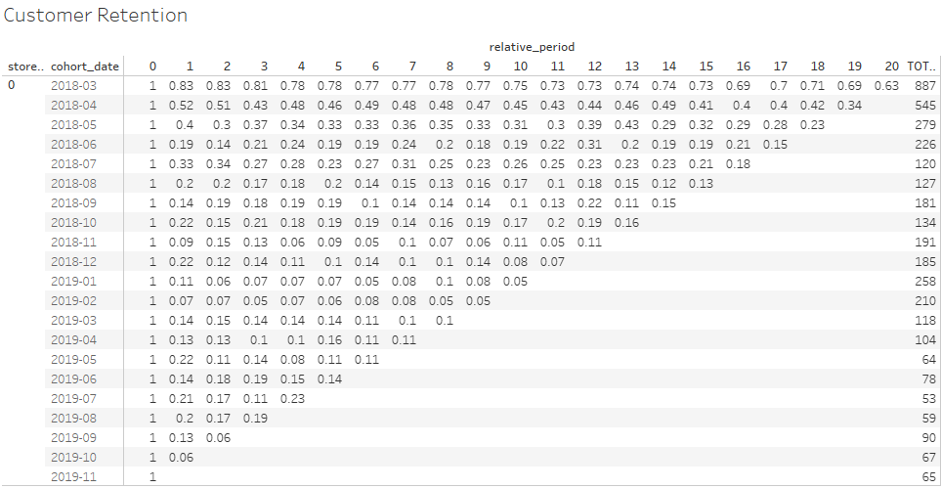
Customer Retention Rate
Indicator of retention of existing customers.

Slide 10
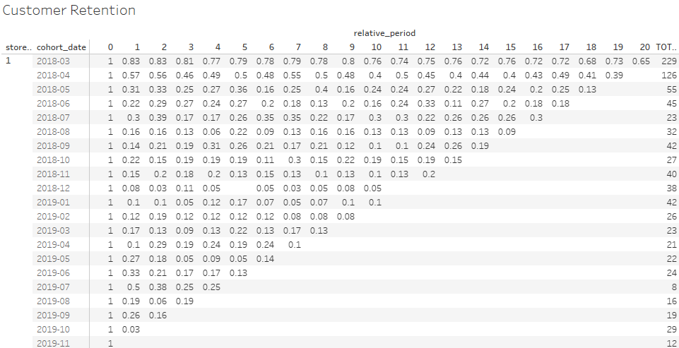

Slide 11
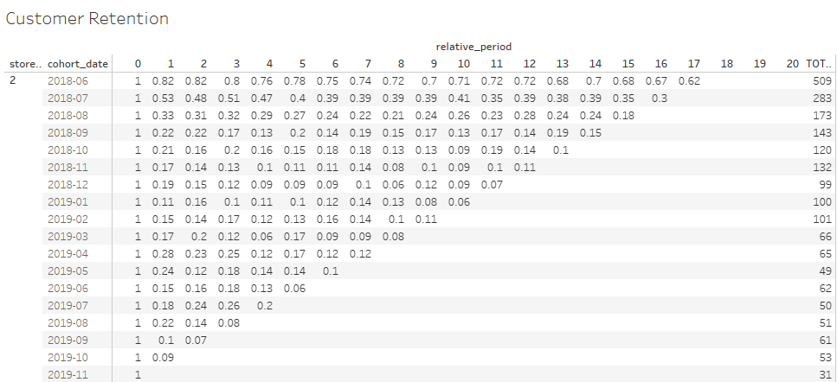

Slide 12
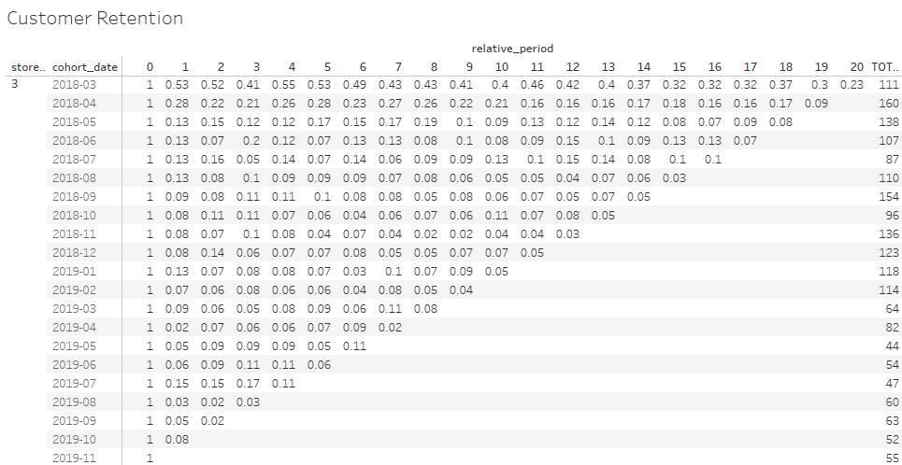

Slide 13
Recommendations
The strategy aims at improving customer engagement at a decently performing store which has a huge scope of improvement in its acquisition and retention rates.
So, considering its high average customer spend value and high repeat rate, if the store at Birmingham (store 1) manages to acquire and retain more customers, its monthly revenue will improve most significantly.
Investing in the store in Birmingham so as to increase customer acquisition and retention rates through diverse marketing and distributional tactics.
Introducing offers and loyalty discounts to customers so as to reduce the churn rate and increase consumer value.

Slide 14
Limitations
It does not take the fixed and variable costs associated with the stores into account. It is important to understand that revenue alone cannot be a measure of gross margin.
Further, no information about the ongoing marketing scheme is presented to study its efficiency relative to product categories or customer segments.

Slide 15
Questions?

Slide 16
Thank you!

